Slide 1
IEEE-802.11 WLAN
Compiled by :- Asst. Prof. Rashmi Pote

Slide 2
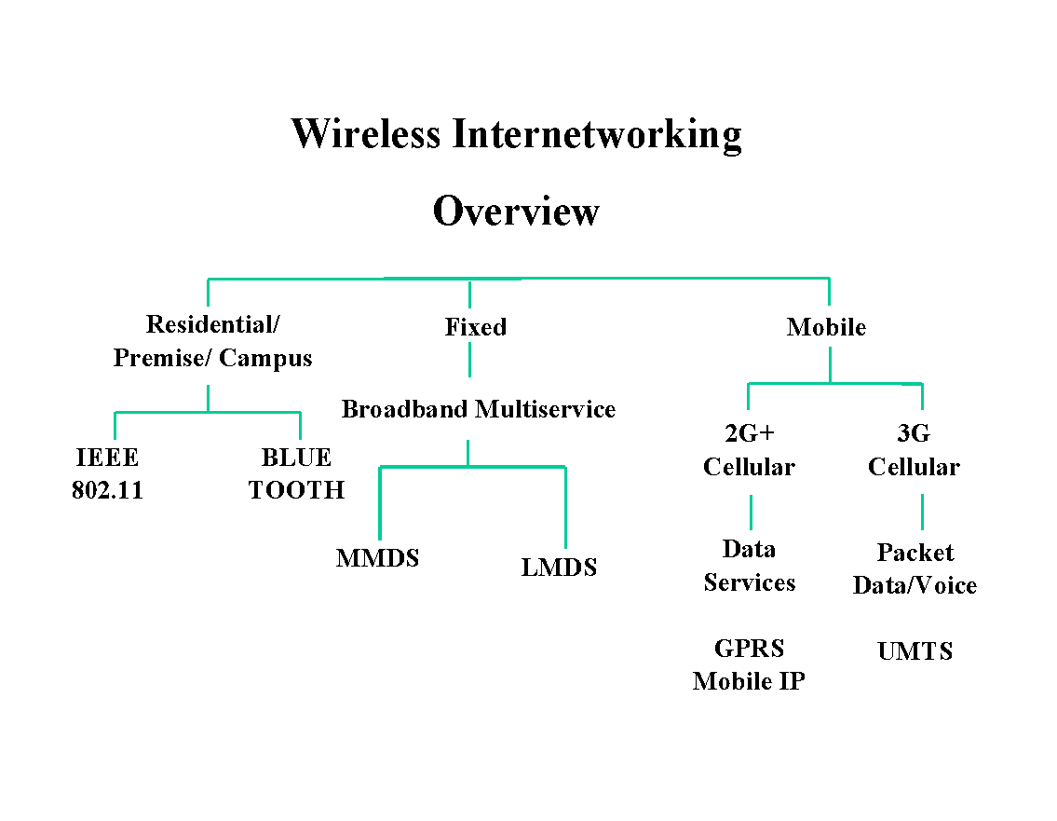
Wireless Market Segments

Slide 3
What is unique about wireless?
Difficult media
interference and noise
quality varies over space and time
shared with Unwanted 802.11 devices
shared with non-802 devices (unlicensed spectrum: microwave ovens, bluetooth, etc.,)
Full connectivity cannot be assumed
Hidden node problem
Multiple international regulatory requirements
Notes:
2

Slide 4
Uniqueness of Wireless (continued)
Mobility
variation in link reliability
battery usage: requires power management
want seamless connections
Security
no physical boundaries
overlapping LANs
Notes:
4

Slide 5
Standardization of Wireless Networks
Wireless networks are standardized by IEEE.
Under 802 LAN MAN standards committee.
Application
Presentation
ISO
OSI
7-layer
model
Session
IEEE 802
standards
Transport
Network
Logical Link Control
Data Link
Medium Access (MAC)
Physical
Physical (PHY)
Notes:
Same organization that came up with IEEE 802.3 Ethernet,
which is responsible for success of Internet

Slide 6
Requirements
Single MAC to support multiple PHYs(is an abbreviation for the physical layer of the OSI model).
PHYs with different medium sense characteristics.
Should allow overlap of multiple networks in the same area and channel space.
Need to be Robust for Interference?
ISM band (Industry, Science and Medicine)
Microwave, other non-802.11 interferers.
Co-channel interference.
Need mechanisms to deal with Hidden Nodes?
Need provisions for Time Bounded Services.
Notes:
5

Slide 7
802.11 Architecture and Overview
Notes:
1

Slide 8
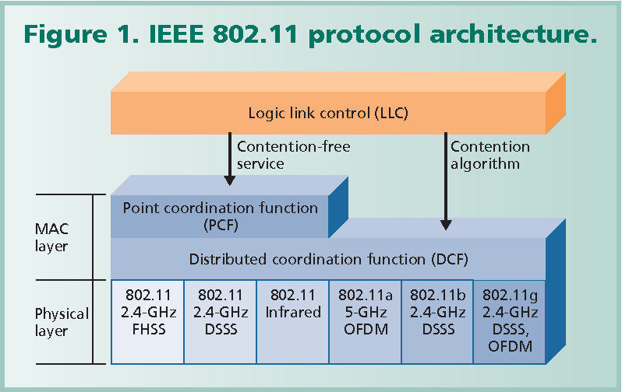
IEEE 802.11 Protocol Architecture

Slide 9
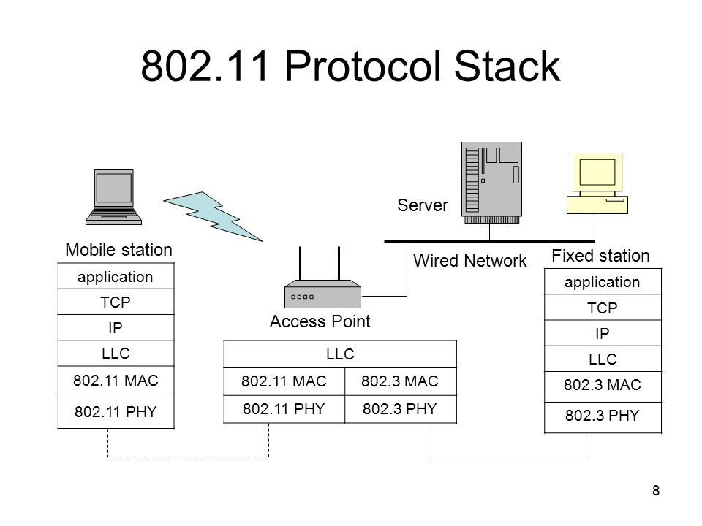

Slide 10
Architecture Overview
One MAC supporting multiple PHYs
Frequency Hopping Spread Spectrum
Direct Sequence Spread Spectrum
Infrared
Orthogonal Frequency Division Multiplexing
Two configurations
Independent (ad hoc) and Infrastructure
Hybrid configuration has been studied
CSMA/CA (collision avoidance) with optional Point Coordination Function (PCF)
Notes:
6

Slide 11
802.11 Protocol Architecture
MAC Entity
basic access mechanism
fragmentation/defragmentation
encryption/decryption
MAC Layer Management Entity
synchronization
power management
roaming
MAC MIB (management information base)
Physical Layer Convergence Protocol (PLCP)
PHY-specific, supports common PHY SAP
provides Clear Channel Assessment signal (carrier sense)
Notes:
8

Slide 12
802.11 Protocol Architecture (cont.)
Physical Medium Dependent Sublayer (PMD)
modulation and encoding
PHY Layer Management
channel tuning
PHY MIB
Station Management
interacts with both MAC Management and PHY Management
Notes:
9

Slide 13
Let’s watch a video
Module-4 Lecture-5 IEEE 802.11 Protocol Architecture
https://www.youtube.com/watch?v=3pRJJCMRukM

Slide 14
Components
Station
BSS - Basic Service Set
IBSS : Infrastructure BSS : QBSS
ESS - Extended Service Set
A set of infrastrucute BSSs.
Connection of APs
Tracking of mobility
DS – Distribution System
AP communicates with another

Slide 15
Services
Station services:
authentication,
de-authentication,
privacy,
delivery of data
Distribution Services ( A thin layer between MAC and LLC sublayer)
association
disassociation
reassociation
distribution
Integration
A station maintain two variables:
authentication state (=> 1)
association state (<= 1)

Slide 16
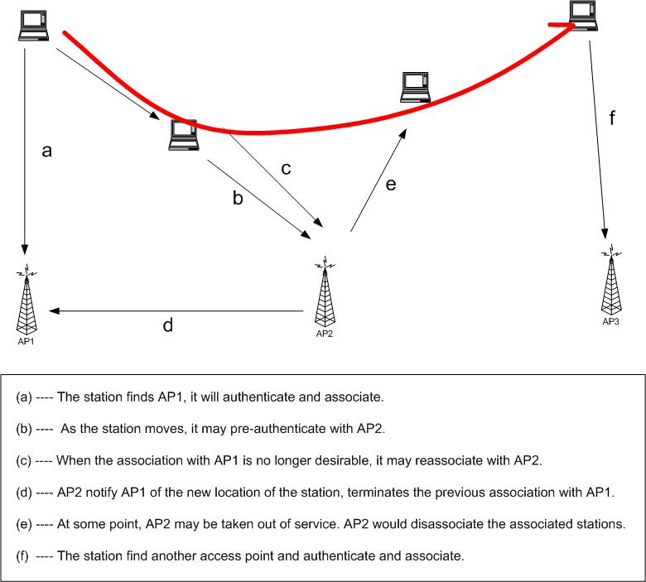
Ex.

Slide 17
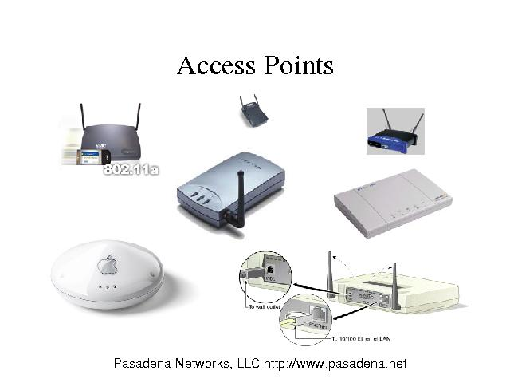
Commercial Products : AP
Notes:
11

Slide 18
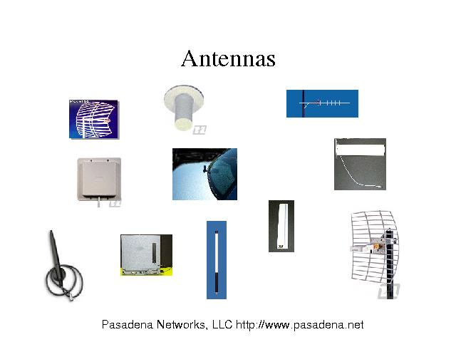
Outdoor Application - Antenna

Slide 19
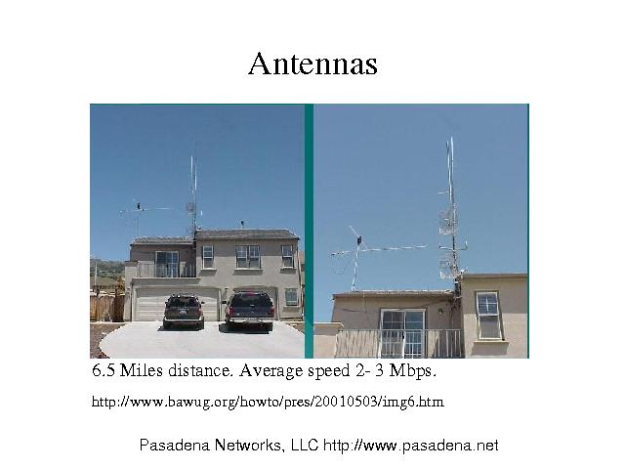
Outdoor Application

Slide 20
Long Distances
Security Issue :
The transmission distance can be up to
25Miles
If the AP is distanced from the street or on a high floor of a building, users will be safe from network trespassers.

Slide 21
Distribution System
Used to interconnect wireless cells
multiple BSS connected together form an ESS (Extended Service Set)
Allows mobile stations to access fixed resources
Not part of 802.11 standard
could be bridged IEEE LANs, wireless, other networks
Only Distribution System Services are defined
Notes:
12

Slide 22
Let’s Watch a Video
802.11ax bringing unprecedented capacity and efficiency to Wi-Fi
https://www.youtube.com/watch?v=HgIJmdzNyIQ

